Slide 1
Optimization of sand business operations: A solver based prescriptive analysis for transportation efficiency.

Slide 2
Team Members
Name:Vikrant nikunj
linkedin.com/in/vikrant-nikunj-279872126

Slide 3
Contents
Problem Statement
Project Overview and Scope
Project Goals
CRISP-ML(Q) Methodology
Technical Stacks
Project Architecture
Data Collection and Understanding
Data Information
Data Dictionary
System Requirements
Exploratory Data Analysis [EDA]
EDA Description
Missing Values Observation
Data Visualization
Model Building
Best Model

Slide 4
Problem Statement
The sand logistics business faces significant challenges in managing its transportation operations efficiently. Key constraints such as variable freight rates, long distances between plants and warehouses, target quantity fulfillment, and overall cost management are currently managed without a data-driven optimization system. This leads to suboptimal routing, increased operational costs, and potential inefficiencies in meeting customer demand.
Therefore, there is a critical need to develop a prescriptive analytics model that can determine the most cost-effective and efficient transportation plan. The solution must optimally allocate shipments from various plants to different warehouses, minimizing total freight costs while adhering to constraints like target quantities and vehicle capacity.

Slide 5
Project Overview and Scope
Prescriptive analysis, in the context of machine learning, refers to the use of historical data, algorithms, and various techniques to provide recommendations on potential actions that can be taken to achieve a desired outcome. It focuses on generating actionable insights and recommendations for future decisions by considering various possible scenarios and their potential outcomes.
Real-Time Transportation Data Integration: Incorporate real-time data for dynamic decision-making in transportation.
Optimized Fleet Transportation Management: Integrate predictive maintenance for efficient management of transportation fleets.
Environmental Impact Analysis in Transportation: Implement eco-friendly transportation strategies to reduce the carbon footprint.
Automation and Autonomous Transportation Vehicles: Explore the use of autonomous vehicles for optimized transportation logistics.
Transportation Demand Forecasting: Use prescriptive analysis for predicting transportation demand and optimizing the supply chain accordingly.

Slide 6
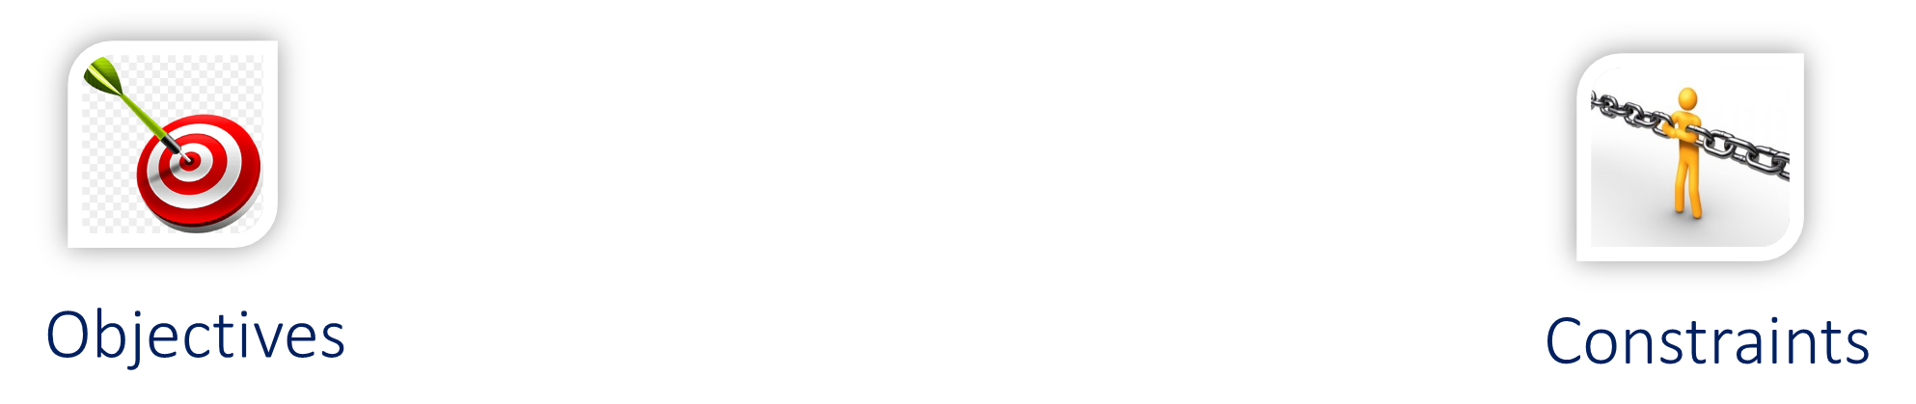
Project Goals
Optimization of sand business operations: A solver based prescriptive analysis for transportation efficiency.
In the logistics business, constraints involve managing time, capacity, regulatory compliance, costs, and infrastructure limitations for efficient transportation operations.

Slide 7
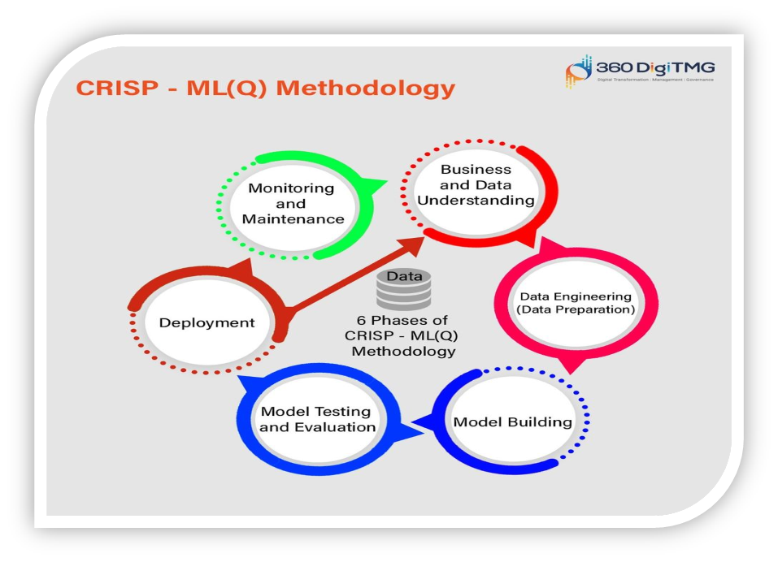
CRISP-ML(Q) Methodology

Slide 8



Technical Stacks
Notes:
Pycharm add Tableau

Slide 9
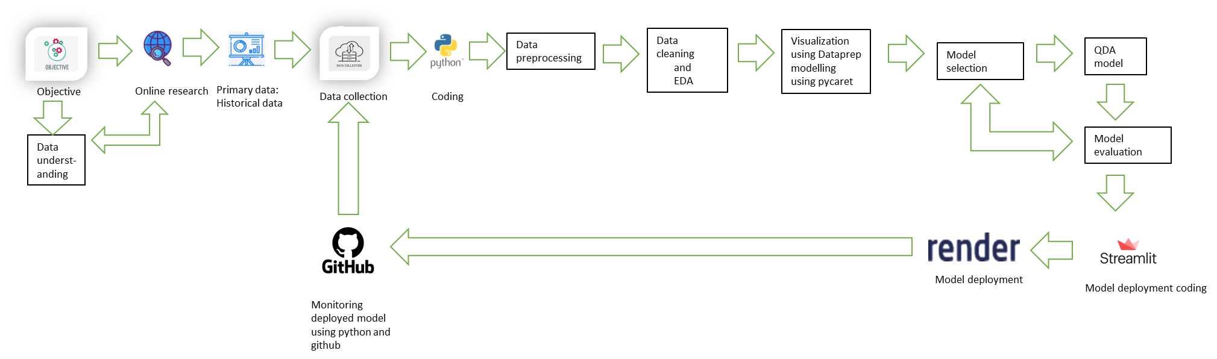



Project Architecture
Tableau
Solver

Slide 10
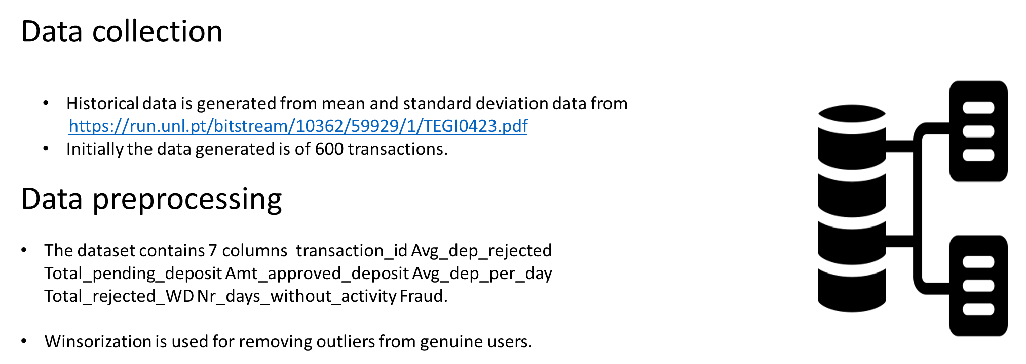







Data Collection and Understanding
Transportation data between plant to warehouse are provided.
In dataset Customer Name ,Plant ,Target ,Quantity, Distance, Freight Rate ,Amount ,
Variables are used.

Slide 11
Data Information
index | Target Quantity | Distance | Freight Rate | Amount
count | 794.0 | 794.0 | 794.0 | 794.0
mean | 257.6700251889169 | 54.10522418136021 | 13.712216624685139 | 37215.79946347607
std | 434.44263773392447 | 21.823561803202033 | 30.872977191702294 | 69751.86711865819
min | 24.0 | 0.0 | 0.0 | 0.0
25% | 50.0 | 38.68 | 2.5 | 6000.0
50% | 100.0 | 51.96 | 2.9 | 11230.68
75% | 200.0 | 68.1865 | 2.9 | 29974.605
max | 3000.0 | 163.916 | 100.0 | 648985.2000000001

Slide 12

Data Dictionary
Name of features | Description | Type | Relevance
Customer name | Customer name | Nominal | Relevant
Plant | Plant | Nominal | Relevant
Target quantity | Target quantity of sands | Count | Relevant
Distance | Distance | Continuous | Relevant
Freight rate | Freight rate | Continuous | Relevant
Amount | Amount considering fright rate , distance and target quantity. | Continuous | Relevant

Slide 13
System Requirements
System requirements:
Memory : 4 GB RAM
CPU : Intel core i3
OS: windows 10.
Prepare environment:
Install python.
Install anaconda software to launch IDE platform like spyder and jupyter notebook.

Slide 14
Exploratory Data Analysis [EDA]
No null values.
Data visualization is done by Tableau.
Notes:
EDA is used for seeing what the data can tell us before the modeling task.
Change

Slide 15
EDA Description
Analyzing the datasets: By using Dataprep automated EDA library ,we analyzed datasets to summarize their statistics for numerical data and creating various graphical representation to understand the data better.
Measure of central tendency:
Mean
Median
Mode
Measure of dispersion:
Standard deviation
Variation
Third and fourth business moment:
Skewness
Kurtosis

Slide 16
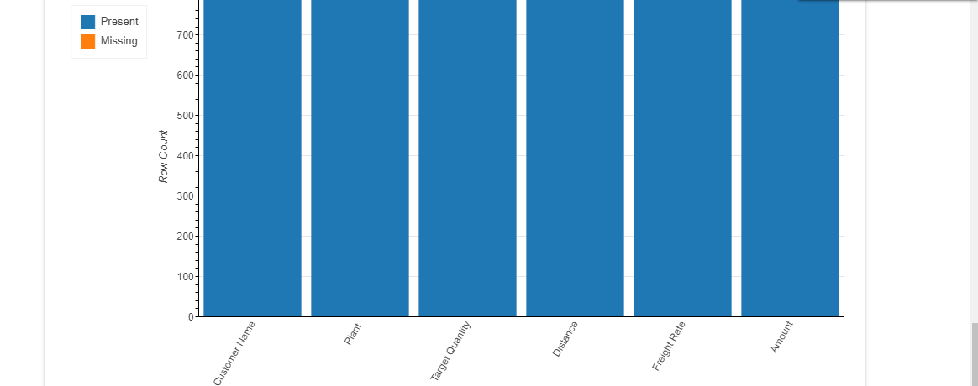
Missing Values Observation

Slide 17


Data Visualization
Notes:
Keep observations

Slide 18
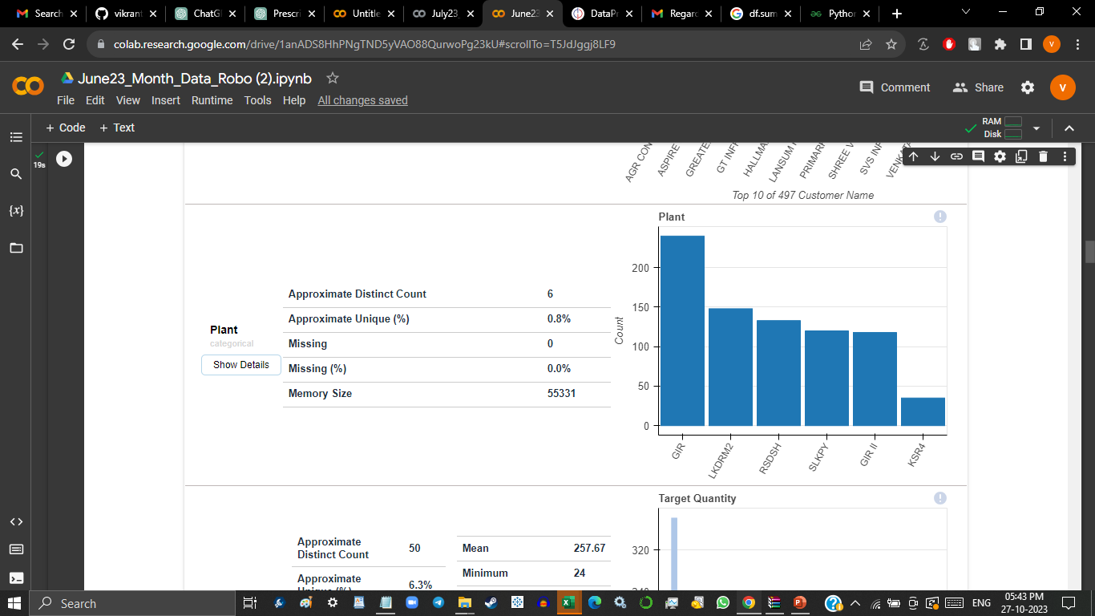
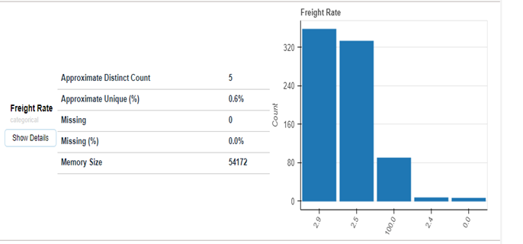
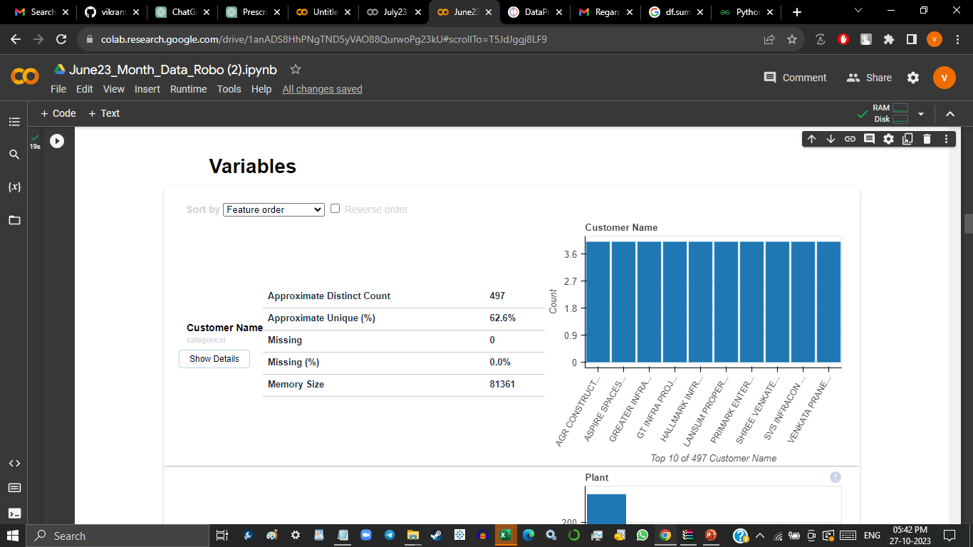
Data Visualization
Notes:
Add graphical

Slide 19
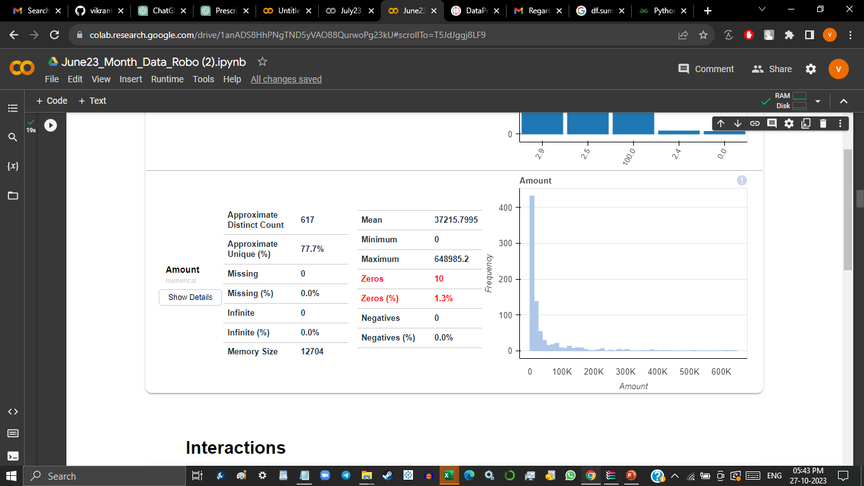
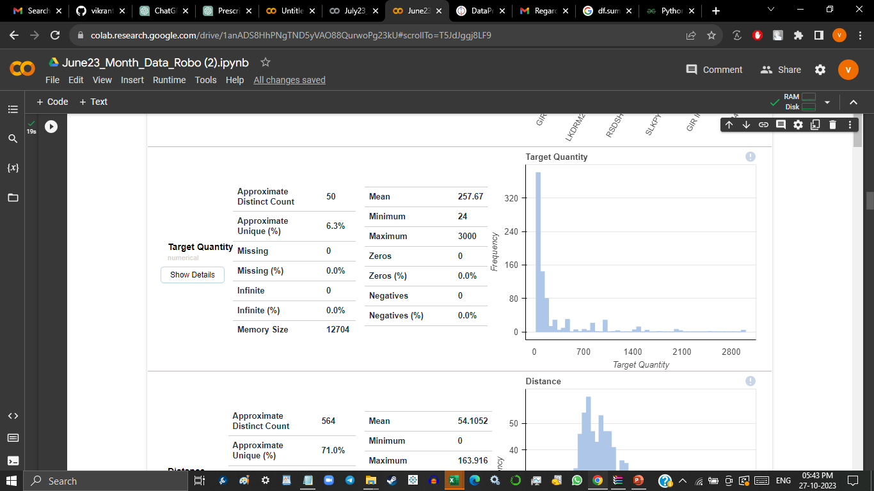
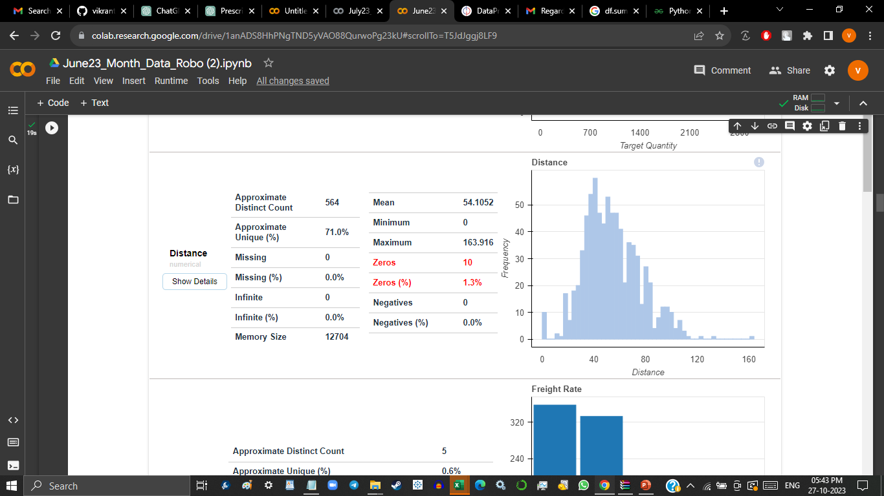
Data Visualization

Slide 20
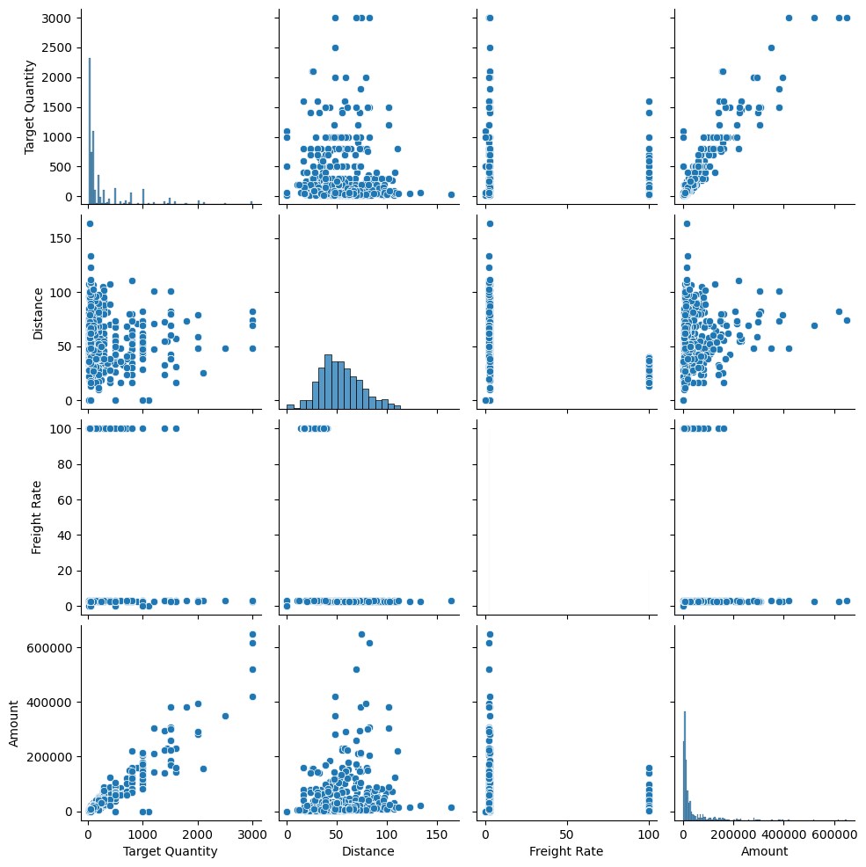
Data Visualization
Notes:
Piee

Slide 21
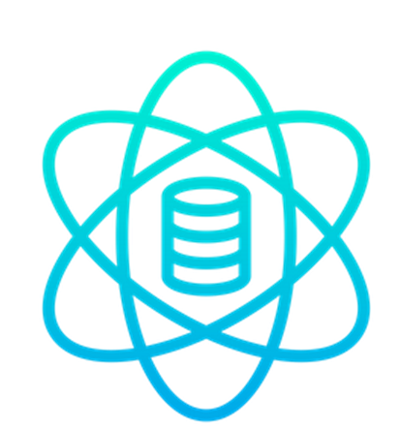
Model Building
Model used:
Pulp library is used for model building.
Notes:
classification is the task of predicting a discrete class label. Regression is the task of predicting a continuous quantity.
What is classification techniques in machine learning?
The Classification algorithm is a Supervised Learning technique that is used to identify the category of new observations on the basis of training data. In Classification, a program learns from the given dataset or observations and then classifies new observation into several classes or groups.
What is regression techniques in machine learning?
Regression is a technique for investigating the relationship between independent variables or features and a dependent variable or outcome. It's used as a method for predictive modeling in machine learning, in which an algorithm is used to predict continuous outcomes.

Slide 22
Best Model – Pulp
The pulp model is a Python library used for modeling and solving linear programming (LP) problems. It allows for the easy formulation of optimization problems with constraints and objective functions. Some specific keywords associated with the pulp model include:
Variables: Represent decision variables in the optimization problem.
Constraints: Define the limitations or restrictions on the decision variables.
Objective function: Represents the goal to be optimized, either maximizing or minimizing a linear expression.
Solver: Determines the method or algorithm used to find the optimal solution.
Optimization: Refers to the process of finding the best solution that satisfies the defined constraints and optimizes the objective function.
Notes:
Why Random Forest Regression is good?
A Random Forest Regression model is powerful and accurate. It usually performs great on many problems, including features with non-linear relationships
How is XGBoost different from random forest?
One of the most important differences between XG Boost and Random forest is that the XGBoost always gives more importance to functional space when reducing the cost of a model while Random Forest tries to give more preferences to hyperparameters to optimize the model..
n_estimators — the number of decision trees you will be running in the model

Slide 23



